Slide 1
Your own game

Slide 2
Vocabulary and grammar | 10 | 20 | 30 | 40 | 50
Curricular | 10 | 20 | 30 | 40 | 50
Culture Corner | 10 | 20 | 30 | 40 | 50
Do you know? | 10 | 20 | 30 | 40 | 50
Russia | 10 | 20 | 30 | 40 | 50

Slide 3
Vocabulary and grammar
10 Match the columns to make word combinations
1. Traffic a) bridge
2. Road b) lane
3. Zebra c) stop
4. Bus d) crossing
5. Underground e) tunnel
6. Foot f) lights
7. Bus g) sign
Answer

Slide 4
Match the columns to make word combinations
Traffic lights
Road sign
Zebra crossing
Bus lane
Underground tunnel
Foot bridge
Bus stop
Return back

Slide 5
Vocabulary and grammar
20 Make up sentences using the following words
1. The, not, cottage, is, but, is, large, comfortable, it.
2. Read, the, and, translate, into, it, article, English.
3. Many, there, stamps, are, new, her, in, collection?
4. Story, a, your, us, told, what, wonderful, father!
Answer

Slide 6
The cottage is not large, but it is comfortable.
Read the article and translate it into English.
Are there many new stamps in her collection?
What a wonderful story your father told us.
Return back

Slide 7
Vocabulary and grammar
30 Match the words to their definitions
1. A large building with apartments
2. An expensive and comfortable flat at the top of a tall building
3. A house which is not joined to another house
4. A house which is joined to another house on one side
5. A large house, usually in the countryside or near the sea, where people stay on holiday
a) Block of flats
b) Semi-detached house
c) Penthouse
d) Villa
e) Detached house
Answer

Slide 8
A large building with apartments
Block of flats
An expensive and comfortable flat at the top of a tall building
Penthouse
A house which is not joined to another house
Detached house
A house which is joined to another house on one side
Semi-detached house
A large house, usually in the countryside or near the sea, where people stay on holiday
Villa
Return back

Slide 9
Vocabulary and grammar
40 Change the verbs in brackets into the correct forms (infinitives or gerunds)
1. I’d like (have) a tuna salad, please.
2. I can’t stand (eat) onions.
3. I look forward to (try) these lemon cakes.
4. Kate would prefer (have) chicken with rice.
5. Do you mind (move) your car, please.
Answer

Slide 10
I’d like to have a tuna salad, please.
I can’t stand eating onions.
I look forward to trying these lemon cakes.
Kate would prefer to have chicken with rice.
Do you mind moving your car, please
Return back

Slide 11
Vocabulary and grammar
50 Choose the correct words.
The drive-through restaurant is one of the USA’s great traditions. It’s unusual because the 1) waiters/customers don’t usually go inside! They drive up to a speaker outside the restaurant, 2) grab/ order their food from a worker and get it from a window. Customers can go inside and eat at a 3) table/ booth, but taking your food to go is more 4) famous/ popular. Drive-throughs are a very popular in the USA and sell a wide
5) range/ type of 6) extra/ fast food, like burgers and fries.
Answer

Slide 12
The drive-through restaurant is one of the USA’s great traditions. It’s unusual because the 1) customers don’t usually go inside! They drive up to a speaker outside the restaurant, 2) order their food from a worker and get it from a window. Customers can go inside and eat at a 3) table, but taking your food to go is more 4) popular. Drive-throughs are a very popular in the USA and sell a wide 5) range of 6) fast food, like burgers and fries.
Return back

Slide 13
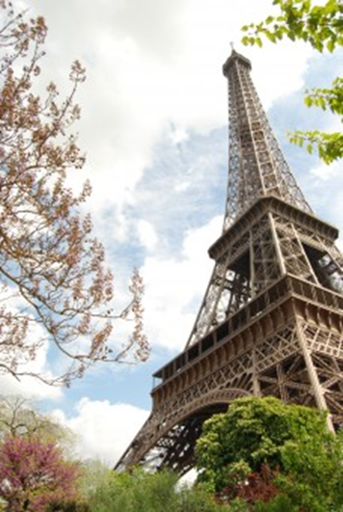
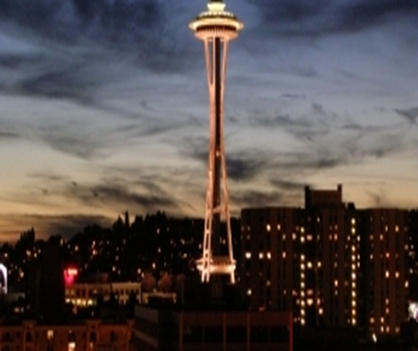
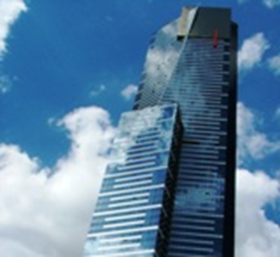
Curricular
10 Art and design
Answer the questions. Choose only one tower.
1. Where is it?
2. What is it made of?
Answer

Slide 14
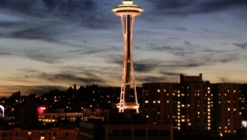

The Space Needle is in Seattle, Washington. It’s made of steel.
The Eiffel Tower is in Paris. It’s made of steel.
Eureka Skydeck 88is in Melbourne, Australia. It’s made of glass.
Return back

Slide 15
Curricular
20 Science
Read the quiz and answer the questions
1. Which well-known reptiles don’t exist anymore?
a) Crocodile b) dinosaurs c) tortoises
2. Which reptiles are poisonous?
a) Iguanas b) alligators c) tiger snakes
3. Where do most reptiles live?
a) In cold places b) in dry places c) in hot places
4. How many legs do most reptiles have?
a) Six b) four c) eight
5. What do most reptiles eat?
a) Meat b) vegetables c) plants
Answer

Slide 16
Read the quiz and answer the questions
Which well-known reptiles don’t exist anymore?
Crocodile b) dinosaurs c) tortoises
Which reptiles are poisonous?
Iguanas b) alligators c) tiger snakes
Where do most reptiles live?
In cold places b) in dry places c) in hot places
How many legs do most reptiles have?
Six b) four c) eight
What do most reptiles eat?
Meat b) vegetables c) plants
Return back

Slide 17
Curricular
30 Geography
Which of the following characterizes tundra and hot desert climate
1. It doesn’t rain very often.
2. It’s very cold even during summertime.
3. Several kinds of plants can live there.
4. There’s no sun during the winter.
5. It can be hot in the morning but freezing cold in the evening.
Answer

Slide 18
Which of the following characterizes tundra and hot desert climate
It doesn’t rain very often. Hot Desert
It’s very cold even during summertime. Tundra
Several kinds of plants can live there. Hot Desert
There’s no sun during the winter. Tundra
It can be hot in the morning but freezing cold in the evening. Hot Desert
Return back

Slide 19
Curricular
40 History
What is true about Native Americans?
1. Homes: wooden houses, skyscrapers, cottages
2. Transport: canoes, dogs sledges, ships
3. Work: fishermen, hunters, waiters
4. Clothes: animal skin, jeans, silk skirts
Answer

Slide 20
What is true about Native Americans?
Homes: wooden houses, skyscrapers, cottages
Transport: canoes, dogs sledges, ships
Work: fishermen, hunters, waiters
Clothes: animal skin, jeans, silk skirts
Return back

Slide 21
Curricular
Answer
50 Science
Which foods are important for keeping these organs/ parts of the body healthy?
Brain | Milk, cheese, yogurt
The skin | Fruit and vegetables, nuts, cereals, oily fish
Muscles | Green vegetables, healthy fats, oily fish, cereals, bread, pasta
Bones | Meat, fish, eggs

Slide 22
Which foods are important for keeping these organs/ parts of the body healthy?
Brain | Green vegetables, healthy fats, oily fish, cereals, bread, pasta
The skin | Fruit and vegetables, nuts, cereals, oily fish
Muscles | Meat, fish, eggs
Bones | Milk, cheese, yogurt
Return back

Slide 23
Culture corner
10 What are the colours of the British flag? How many crosses are on it?
Answer

Slide 24
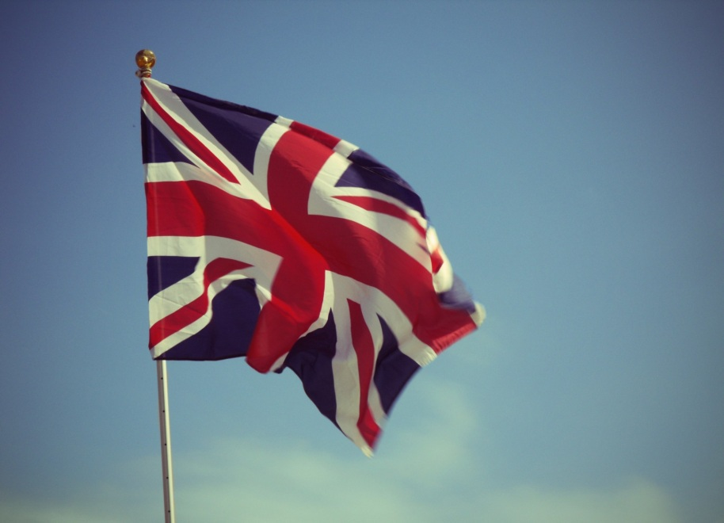
The colours of the UK flag are red, white and blue. It has got three crosses.
Return back

Slide 25
Culture corner
20 1. The Statue of Liberty is … tall.
a) 43 m b) 53 m c) 37 m
2. The Empire State Building is a skyscraper with … floors.
a) 100 b) 102 c) 95
3. The Central park has got lakes, restaurants and …
a) A Zoo and a skating rink b) a swimming pool and a cinema c) a water park and a circus.
Answer

Slide 26
1. The Statue of Liberty is … tall.
a) 43 m b) 53 m c) 37 m
2. The Empire State Building is a skyscraper with … floors.
a) 100 b) 102 c) 95
3. The Central park has got lakes, restaurants and …
a) A Zoo and a skating rink b) a swimming pool and a cinema c) a water park and a circus.
Return back

Slide 27
Culture corner
30 At what age do pupils attend secondary school?
What subjects do they learn?
What do pupils do after school activities?
Answer

Slide 28
At what age do pupils attend secondary school?
11-16
What subjects do they learn?
English, Maths, Science, Geography, Art
What do pupils do after school activities?
Play football, hockey, attend the school choir, perform in musical events
Return back

Slide 29
Culture corner
40 What were the most famous bands in the 1960s?
What modern equipment did people have in the 60s?
What astronaut walked on the moon?
Answer

Slide 30
What were the most famous bands in the 1960s?
The Beatles, the Rolling Stones
What modern equipment did people have in the 60s?
A television
What astronaut walked on the moon?
Neil Armstrong
Return back

Slide 31
Culture corner
50 …This large gothic church in the centre of London is the place where kings and queens of England are traditionally crowned, married and buried. Here you can see the tombs of some very famous figures in history including Henry III, Isaac Newton and Charles Darwin as well as visit the museum…
What famous sight of London is described in the extract?
A) Tate Modern b) Westminster Abbey c) the Tower of London
Answer

Slide 32
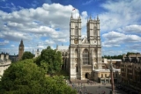
What famous sight of London is described in the extract?
b) Westminster Abbey
Return back

Slide 33
Do you know?
10 What do people call “the land of the midnight sun”?
Answer

Slide 34
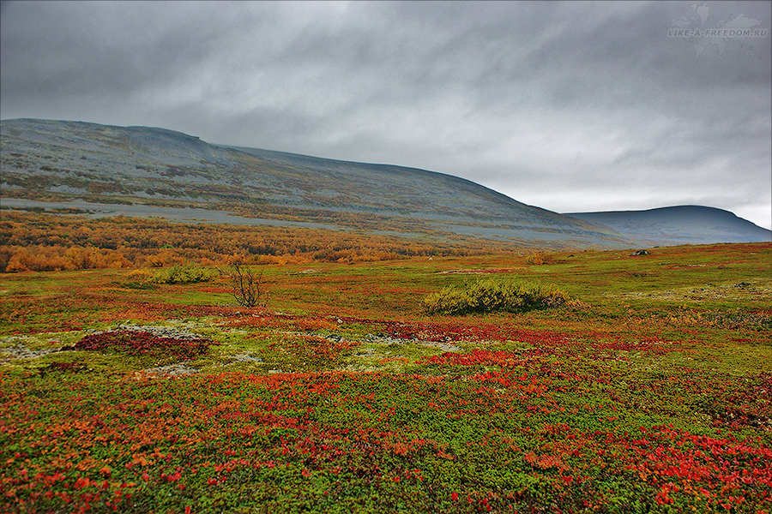
What do people call “the land of the midnight sun”?
The tundra
Return back

Slide 35
Do you know?
20 Where did the Vikings live?
Answer

Slide 36
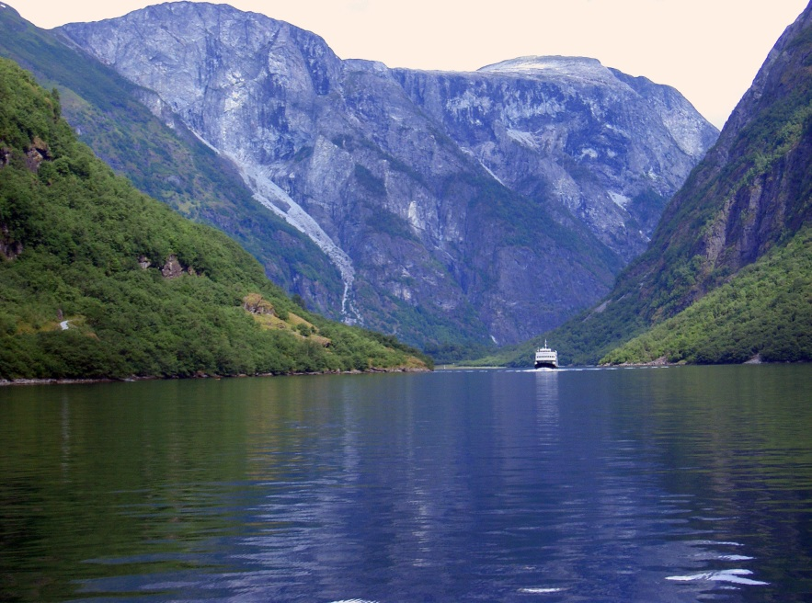
Where did the Vikings live?
In Scandinavia
Return back

Slide 37
Do you know?
30 Where is Machu Picchu?
Answer

Slide 38
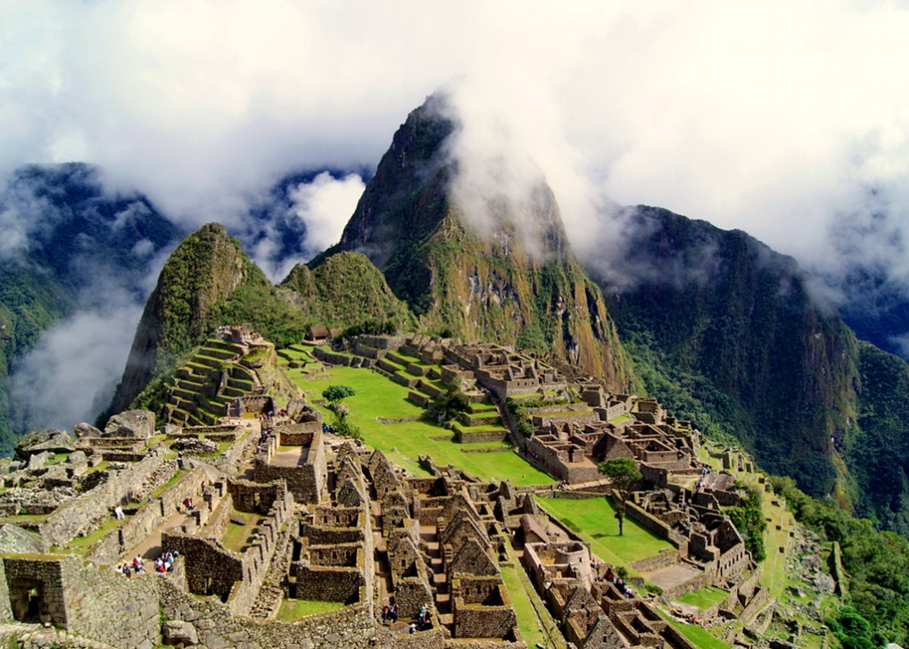
Where is Machu Picchu?
In Peru
Return back

Slide 39
Do you know?
40 What is a chippy?
Answer

Slide 40
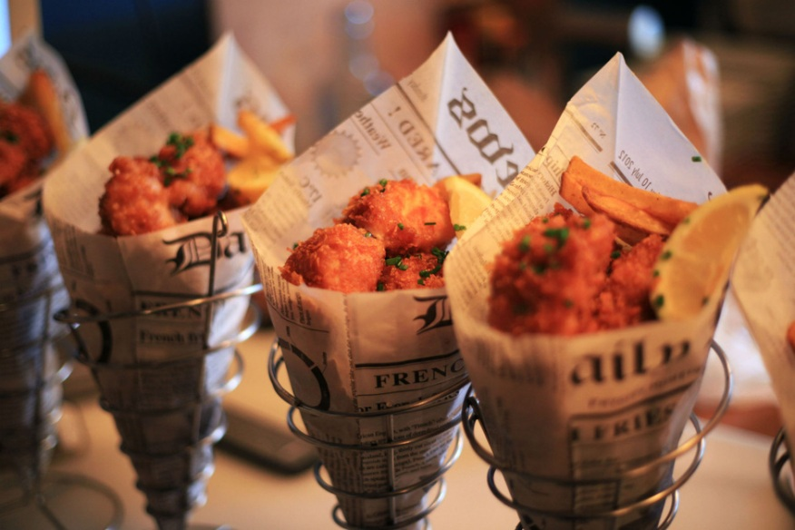
What is a chippy?
A fish’n’chips shop/restaurant
Return back

Slide 41
Do you know?
50 How much energy does our brain use?
Answer

Slide 42
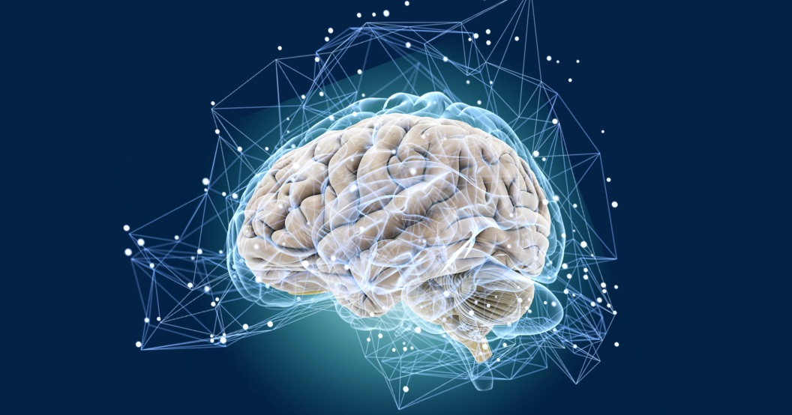
How much energy does our brain use?
Our brain uses 20% of energy
Return back

Slide 43
Russia
10 When did Russian astronaut Y. Gagarin fly into space?
Answer

Slide 44
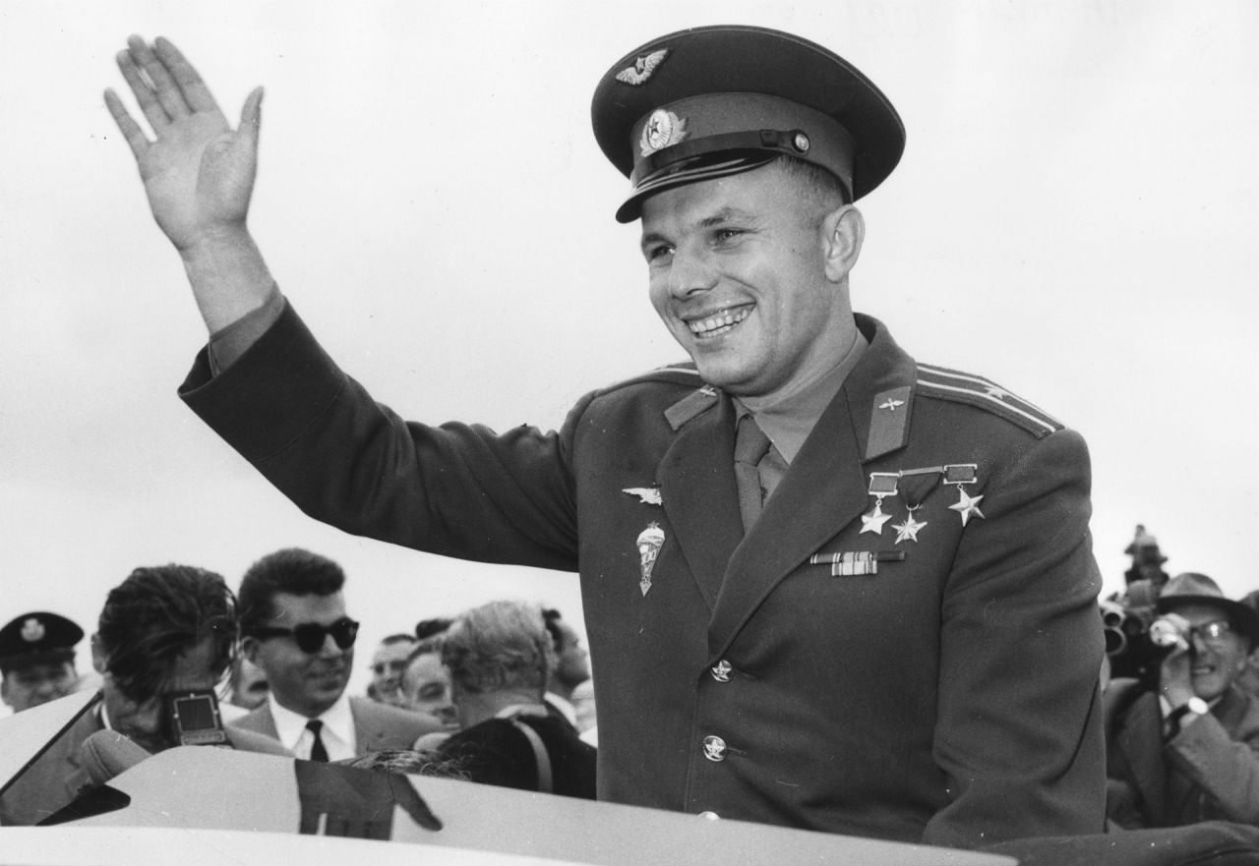
When did Russian astronaut Y. Gagarin fly into space?
On April 12, 1961.
Return back

Slide 45
Russia
20 What (job) did Konstantin Tsiolkovsky do?
Answer

Slide 46
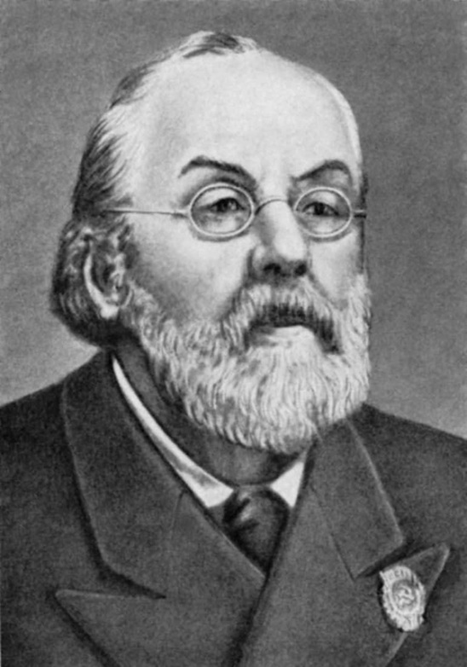
What (job) did Konstantin Tsiolkovsky do?
A Russian rocket scientist.
Return back

Slide 47
Russia
30 Why is caviar called “food of the Tsars”?
Answer

Slide 48
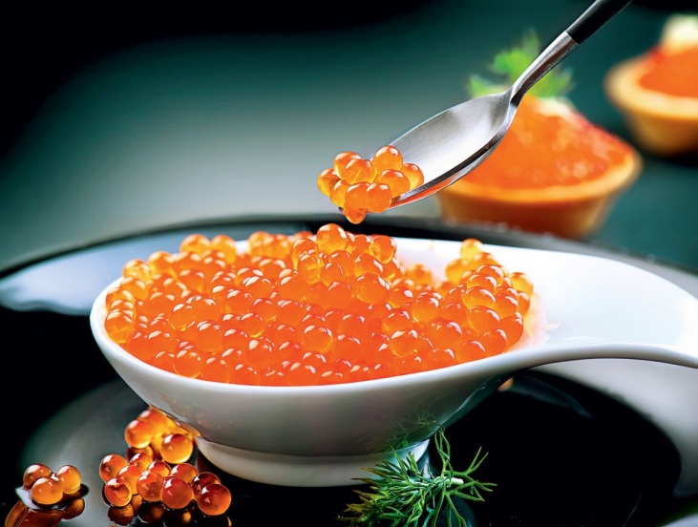
Why is caviar called “food of the Tsars”?
It is called “food of the Tsars” because it used to be the favourite food of various Russian Tsars.
Return back

Slide 49
Russia
40 Where is Krasnay Polyana? What is Krasnay Polyana famous for?
Answer

Slide 50
Where is Krasnay Polyana? What is Krasnay Polyana famous for?
Krasnaya Polyana is the most modern ski and snowboard resort in Sochi, Russia. It is famous for its skiing pistes and its after-ski cafes.
Return back

Slide 51
Russia
50 During the reign of Catherine the Great, Russia became one of the great powers of Europe in the 18th century. What did Catherine the Great develop during her reign?
Answer

Slide 52
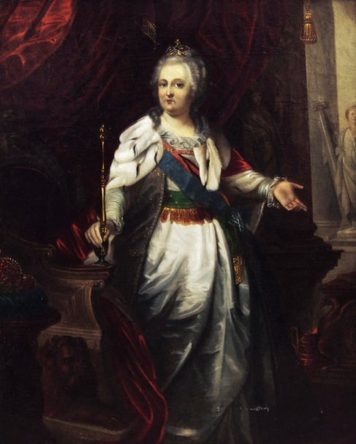
What did Catherine the Great develop during her reign?
The arts, sciences, the education system.
Return back

